Slide 1
Agile Requirements Techniques: Delivering Value Sooner

Slide 2
About Me
20+ years experience working in the software development field various industries.
Experience spans the entire end-to-end software development lifecycle with
Program/Project Management
Management Consulting
Quality Assurance & Control
Release Management
Development
Technical Support
10+ years experience as a Scrum Master, Agile Trainer and Agile Coach

Slide 3
Agenda
Understand why Stories are used for requirements in Agile.
Appreciate the discipline needed to effectively refine Stories based on their priority.
Understand how to decompose Stories into finer grain work items.
Learn how to slice stories vertically through the software architectural layers to provide increments of value.
Learn how to capture nonfunctional requirements via Stories.
Learn what the different types of Stories there are in order to capture different user needs.
Get exposed to the concept of a Minimal Viable Product and why it accelerates value delivery and learning.

Slide 4
Pop Quiz: WF Requirements
50%
What percentage of overall project time is spent gathering, elaborating, and communicating product requirements?
What percentage of requirements, as originally defined, change during the course of the project?
What percentage of features, as ultimately delivered, are rarely or never used by the product’s end-users?
35%
45%

Slide 5
Delivering Value Sooner
12 month cycle to deliver value

Slide 6
The 5 Levels of Planning
- torak.com

Slide 7
What is a User Story
A brief, simple requirement statement from a user’s perspective.
As a <user role>,
I want to <goal>,
So that <desired benefit>.
Acceptance
Criteria
- Davisbase
Notes:
The BABOK® Guide considers User Stories a technique and defines it as follows:
9.33 User Stories
9.33.1 Purpose
User Stories are a brief description of functionality that users need from a solution
to meet a business objective.
9.33.2 Description
A user story is a textual description of things that the solution needs to allow users
to do. User stories are typically a sentence or two that describes who uses the story,
the goal they are trying to accomplish, and any additional information that may be
critical to understanding the scope of the story.
9.33.3 Key Features
A user story includes a short description of the problem to be solved. This is from
the perspective of the user. The only detail that needs to be included is information
that reduces the risk of misunderstanding by developers that create the estimate.
A user story includes:
Actor: Stakeholder who benefits from the user story.
Description: A high-level overview of what functionality the user story includes.
Benefit: The business value the story delivers. A user story should also have defined Acceptance and Evaluation Criteria (9.1).
___________________________________________________________________________________
___________________________________________________________________________________
___________________________________________________________________________________

Slide 8
Parts of a User Story
1
Who
As a <user role>,
I want to <goal>,
So that <desired benefit>.
2
What
3
Why
Acceptance
Criteria
4
- Davisbase
Notes:
Traditional requirements typically state requirements in one of the following constructs:
The system shall…
The user will have the ability to…
Do this…
User Stories help teams focus on building the right thing at the right time by demanding:
WHO: If a stakeholder cannot specify who will actually use the feature, then why should we build it?
WHAT: If a stakeholder cannot specify what it is the person needs, then why should we build it?
WHY: If a stakeholder cannot specify why something is needed, then why should we build it?
Providing the 3 key-parts of a User Story help to decrease the 65% of features that are rarely or never used by end-users.
___________________________________________________________________________________
___________________________________________________________________________________
___________________________________________________________________________________
___________________________________________________________________________________
___________________________________________________________________________________
___________________________________________________________________________________
___________________________________________________________________________________
___________________________________________________________________________________
___________________________________________________________________________________

Slide 9
Information Associated with a Story
Title: a conversation starter
Title: Traveller wants to book a trip so that they can go to their destination
Story points : 3
Assigned to : Tom
Body
Acceptance tests:
User can edit an airline booking
User can edit a car rental booking
User can edit a hotel booking
User can start editing from a screen that shows a booking
Other information:
Attachments
Screenshots
UML
Discussion
Non-goals
Additional details
Notes:
The story on a story card is really just the “title” of the story. You can have whatever else you want in the body that helps you implement the story. But nothing that can be in the body should be in the title. The title should be totally focused on the “who” “what” and “why” and not the “how” of the story.
The body elaborates on all of these: who, what, why, how.

Slide 10
Benefits of User Stories
User Stories emphasize verbal rather than written communication.
User Stories are comprehensible by both customers and developers, encouraging greater levels of customer participation.
User Stories are the right size for planning.
User Stories are well suited for iterative development.
User Stories force requirements validation by stating both WHO will use a feature & WHY it is desired.
Notes:
____________________________________________________________________________________________
___________________________________________________________________________________
___________________________________________________________________________________
___________________________________________________________________________________
___________________________________________________________________________________
___________________________________________________________________________________
___________________________________________________________________________________
___________________________________________________________________________________
___________________________________________________________________________________
___________________________________________________________________________________
___________________________________________________________________________________
___________________________________________________________________________________
___________________________________________________________________________________
___________________________________________________________________________________

Slide 11
What Are User Stories Used For?
User stories are the basis for all work
All development work should be based on user stories, no matter where those developers physically sit
All test plans should be based around user stories, no matter who is doing the testing
User stories may be insufficient for documenting the current architecture or functioning of the system
In this case, documentation for this specific purpose may be used
This documentation should not be used as the basis for development and testing, only as reference material or for auditing purposes
Notes:
The idea for a story can come from anywhere
Any team member can create a story
The product owner is the single wring able neck for the backlog.

Slide 12
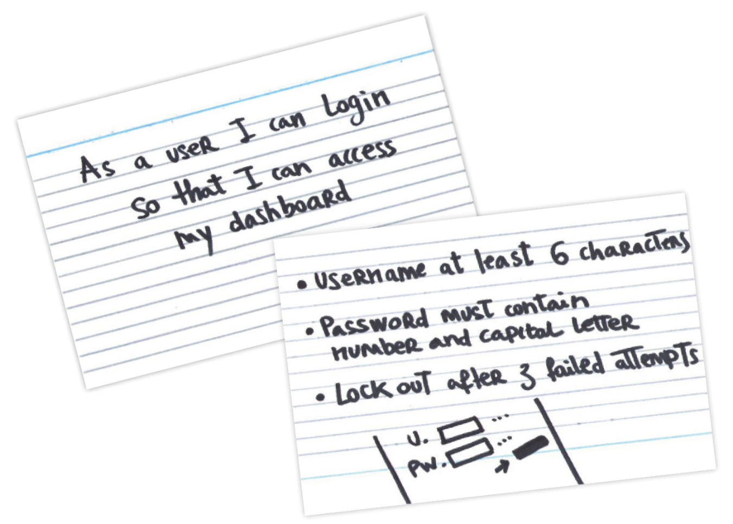
Acceptance Criteria
Acceptance Criteria as “Conditions that a software product must satisfy to be accepted by a user, customer or other stakeholder.”
Acceptance Criteria are a set of statements, each with a clear pass/fail result, that specify both functional (e.g., minimal marketable functionality) and non-functional (e.g., minimal quality) requirements
- manifesto.uk
- seguetech.com

Slide 13
The 3 C’s of a User Story
The Card - A 3x5 index card forces brevity. Only capture the topic of the item, a high level description of the desired system behavior, and why it is important.
The Conversation - A User Story it not enough. Consider it a placeholder for conversation. Detailed requirements are only discovered once the story has been targeted for a sprint.
The Confirmation - On the back of the card capture Acceptance Criteria. They outline specifications from the Product Owner and will allow the team build functionality for acceptance.
Notes:
____________________________________________________________________________________________
___________________________________________________________________________________
___________________________________________________________________________________
___________________________________________________________________________________
___________________________________________________________________________________
___________________________________________________________________________________
___________________________________________________________________________________
___________________________________________________________________________________
___________________________________________________________________________________
___________________________________________________________________________________
___________________________________________________________________________________
___________________________________________________________________________________
___________________________________________________________________________________
___________________________________________________________________________________
Ron Jeffries is the author that identified the 3 C’s of User Stories.

Slide 14
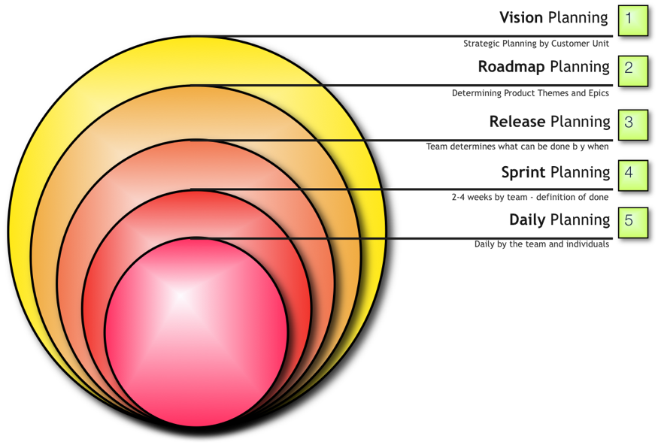
Where User Stories Fit In
Must have User Stories written, estimated & prioritized prior to Release Planning.
- Davisbase
Notes:
____________________________________________________________________________________________
___________________________________________________________________________________
___________________________________________________________________________________
___________________________________________________________________________________
___________________________________________________________________________________
___________________________________________________________________________________
___________________________________________________________________________________
___________________________________________________________________________________
___________________________________________________________________________________
___________________________________________________________________________________
___________________________________________________________________________________
___________________________________________________________________________________
___________________________________________________________________________________
___________________________________________________________________________________

Slide 15
Product Backlog
A prioritized list of all user stories that may be delivered
New items can be added at any time to the Product Backlog
Items are defined and prioritized by Product Owner with input from others
Team members estimate items in Product Backlog relative to each other using predetermined scale (story points)
Notes:
The Product Backlog is very simply a list of everything we know about so far to be accomplished for project success. It is analogous to an inventory of items to be delivered. Because projects and products evolve over time, the Backlog can change at any time--adding, subtracting and clarifying as the Agile Team learns more about the User needs.
In order for the Product Backlog to be of value, elements of the Backlog must have three things: what is being asked for, the priority of those things, and a sense of the effort required to complete those things.
•What is being asked for: Typically stated in the form of User Stories
•Priority: variety of possible paradigms and approaches
•Relative Estimating: Story Points

Slide 16
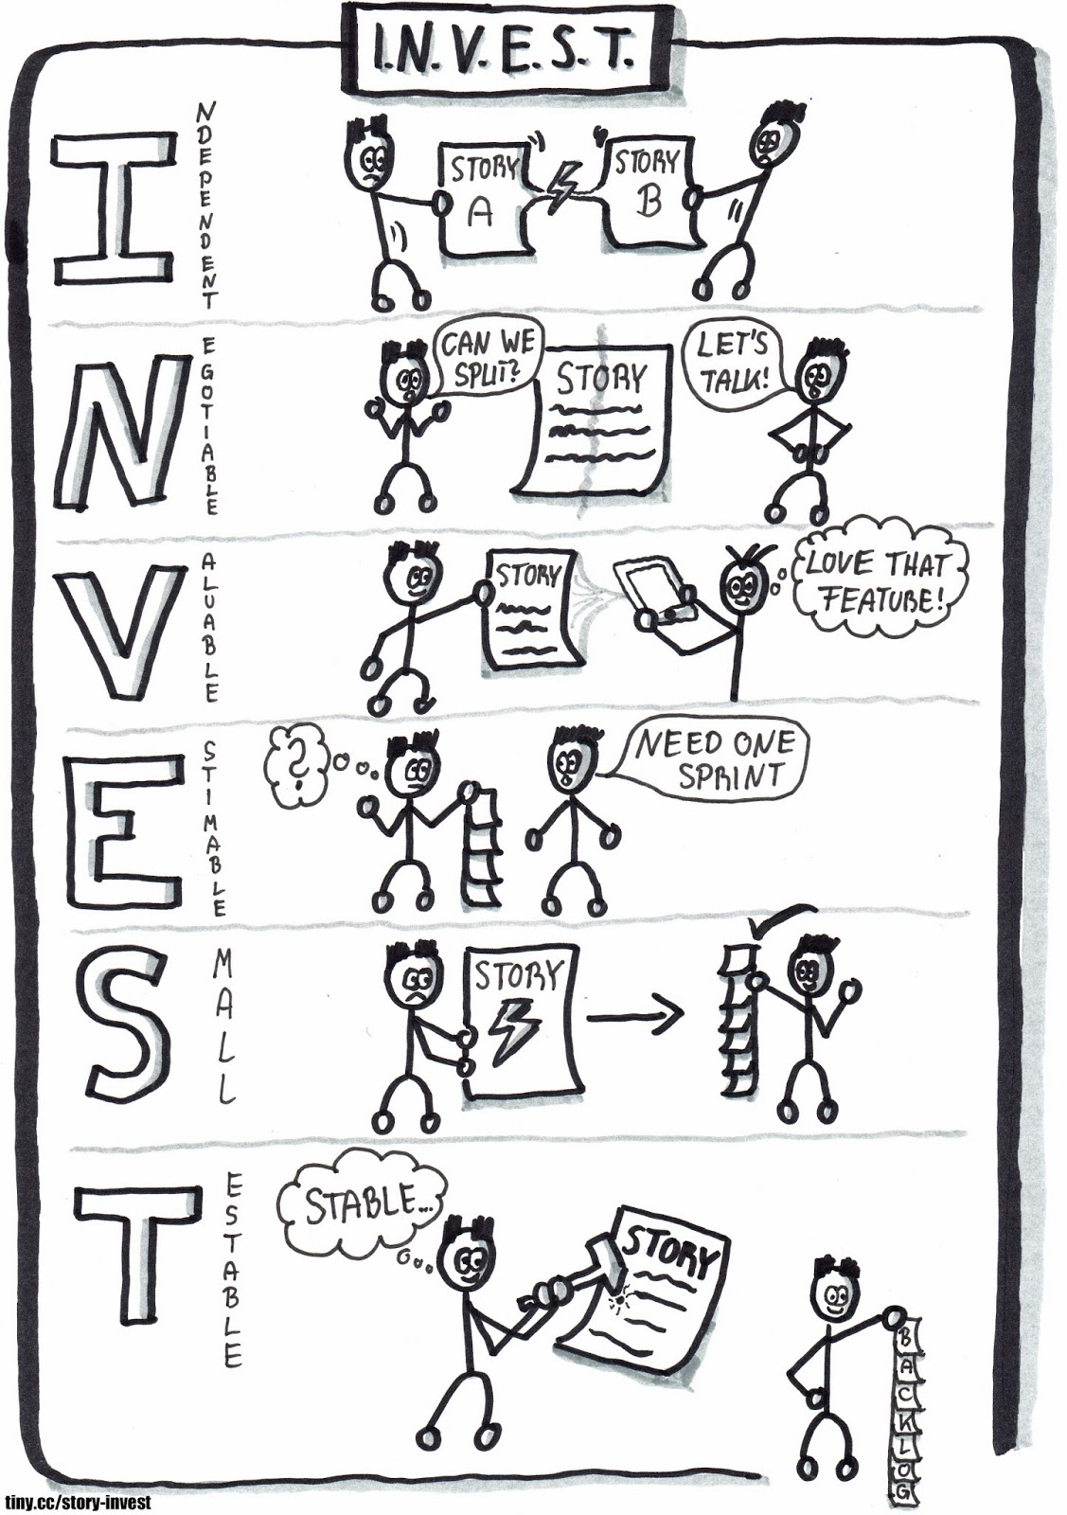
I.N.V.E.S.T.ing
Independent
Negotiable
Valuable
Estimable
Small
Testable
- Agile Planet

Slide 17
Who writes stories?
Everyone.
Driven from Product Owner
Assisted by the Team
Requires Collaboration
Together as a team you can be successful.
Notes:
____________________________________________________________________________________________
___________________________________________________________________________________
___________________________________________________________________________________
___________________________________________________________________________________
___________________________________________________________________________________
___________________________________________________________________________________
___________________________________________________________________________________
___________________________________________________________________________________
___________________________________________________________________________________
___________________________________________________________________________________
___________________________________________________________________________________
___________________________________________________________________________________
___________________________________________________________________________________
___________________________________________________________________________________

Slide 18
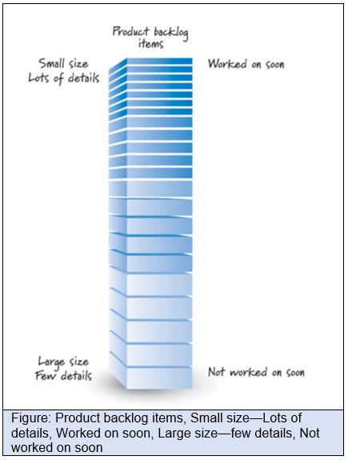
Prioritizing the Backlog
Financial Criteria
Decision Matrix
MoSCoW
KANO

Slide 19
User Roles
Why are User Roles important?
Unique perspectives change requirements and acceptance criteria
Who are your target customers?
What do they use the software for?
How do they use the software?
What are their priorities?
Notes:
One of the Agile Principles states that our "highest priority is to satisfy the customer." Unfortunately, the "customer" is too broad a term to be useful to an Agile team. In the minds of a technical team, the term "customer" often gets replaced by the even-more-generic term "User," with the underlying implication that all users interact with the product/software in the same way. Even worse, “customer” could be interpreted as the internal stakeholder that is funding the project and that the team is interacting with, whether or not that person is actually a “user” of the system at all.
The User Role is an attempt by the Agile team to add some clarity to the term "user." The team recognizes that there are multiple different types of users, and that each type will interact with the system in a different way, with different priorities, goals and needs. By identifying those different "constituencies", the Agile team can more easily prioritize the work to be done, making sure that the highest impact users will receive the most valuable features and functions first.
We do this by defining User Roles, and asking clarifying questions, such as:
What is this type of User doing while they are using the software?
What are their business priorities, and how does using this software fit into those priorities?
How do they interact with this software--in what setting, in what environment and using what delivery mechanism?
Other relevant questions regarding their behavior and needs
By asking these relevant questions--and using the answers to guide system development--the Agile team can ensure that the end product adds the most possible value. Far too often product teams deliver against a static set of requirements, only to find that the "solution" was more difficult to use than the problem it was intended to solve. One of the ways to mitigate against that eventuality is to define who the users are (User Roles) and what they need.

Slide 20
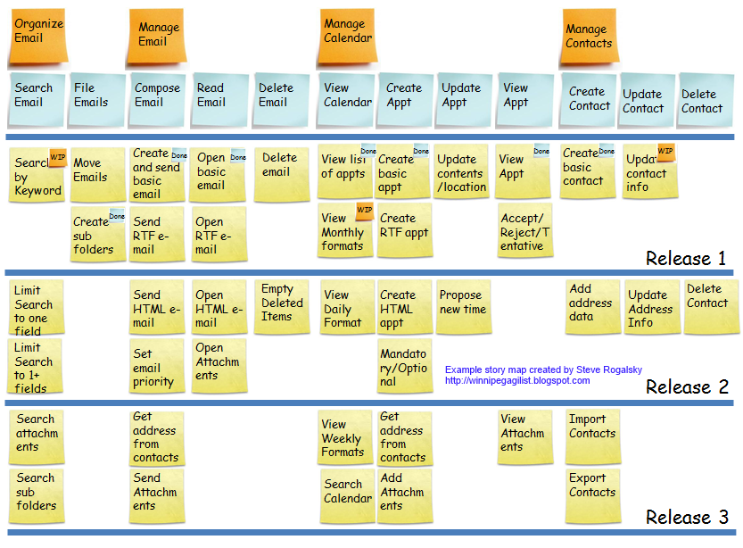
Story Mapping
- winnipegagilist.com

Slide 21
Lifecycle of a Story
High-level acceptance criteria defined
Story is Prioritized in backlog
Story is Estimated
Story is planned for a Release
Story is targeted for a Sprint
Story is Written
By anyone on team
By PO, BAs
By PO w/ Team input
By Team
By Team w/ PO input
By Team w/ PO input
Story’s tasks are completed
Story’s Tasks are defined
Story is Accepted
Story is Demo’d
Story is Reviewed
Story is Groomed
By Product Owner
By Team
By team
By team
By Team
By Team & PO
Sprint
- Davisbase
Notes:
____________________________________________________________________________________________
___________________________________________________________________________________
___________________________________________________________________________________
___________________________________________________________________________________
___________________________________________________________________________________
___________________________________________________________________________________
___________________________________________________________________________________
___________________________________________________________________________________
___________________________________________________________________________________
___________________________________________________________________________________
___________________________________________________________________________________
___________________________________________________________________________________
___________________________________________________________________________________
___________________________________________________________________________________

Slide 22
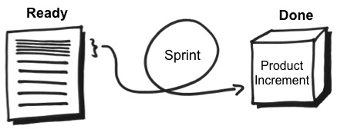
Defining Ready
- romanpichler.com

Slide 23
Typical Ingredients in Definition of Ready
Meets the INVEST criteria
Has acceptance criteria
Very little to no research, or all research
If a lot of research is required for a story, create a research-only story and time-box it
The story is estimated
UAT is well understood
Preferably fully stated as part of story… or…
QA person proxy for UAT tester
Whole team feels comfortable that they know what it takes to get story to “done”
The whole team has contributed to the grooming/estimation of the story
Notes:
As a team you should have a clear definition of ready
Transparency!
Push back and kick it down the line if it isn’t ready
Don’t accept stories into an iteration until really ready

Slide 24
Backlog Refinement
Product backlog refinement—sometimes called product backlog grooming in reference to keeping the backlog clean and orderly—is a meeting that is held near the end of one sprint to ensure the backlog is ready for the next sprint.
- mountaingoatsoftware.com

Slide 25
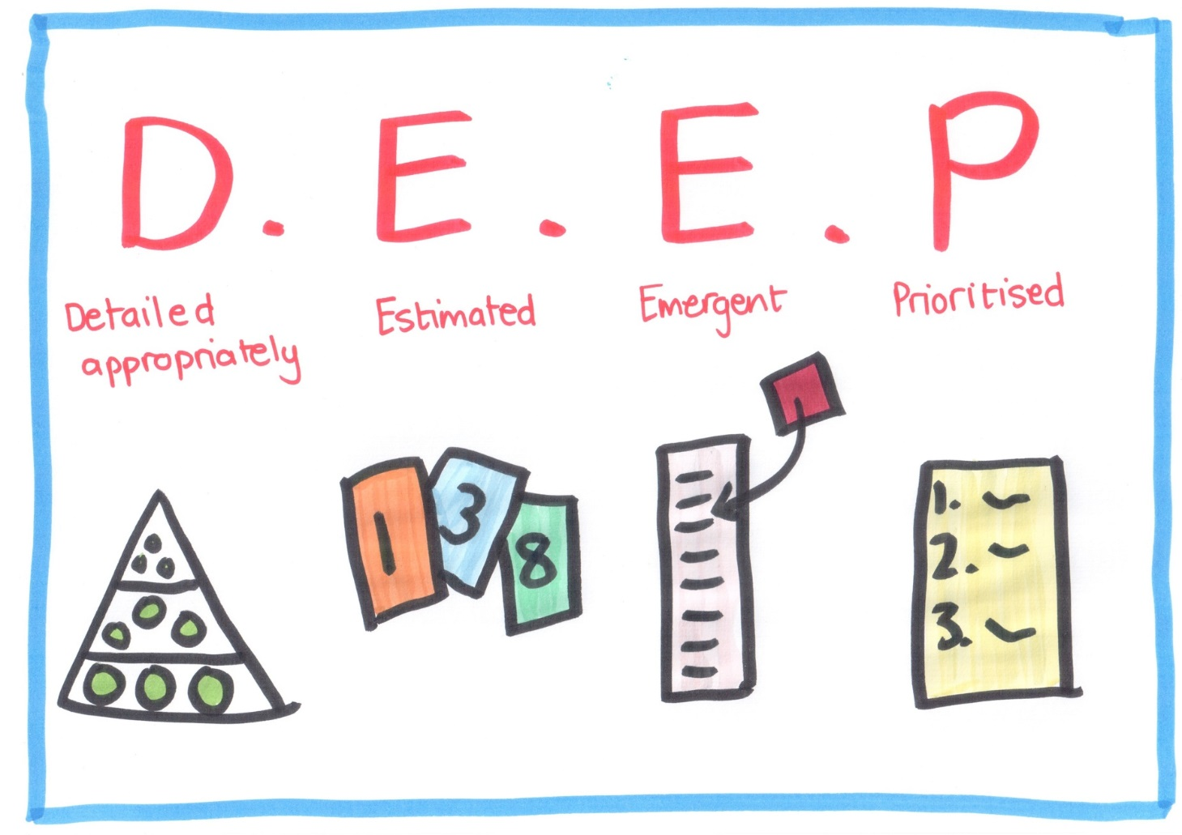
Refining the Backlog
- leanpub.com

Slide 26
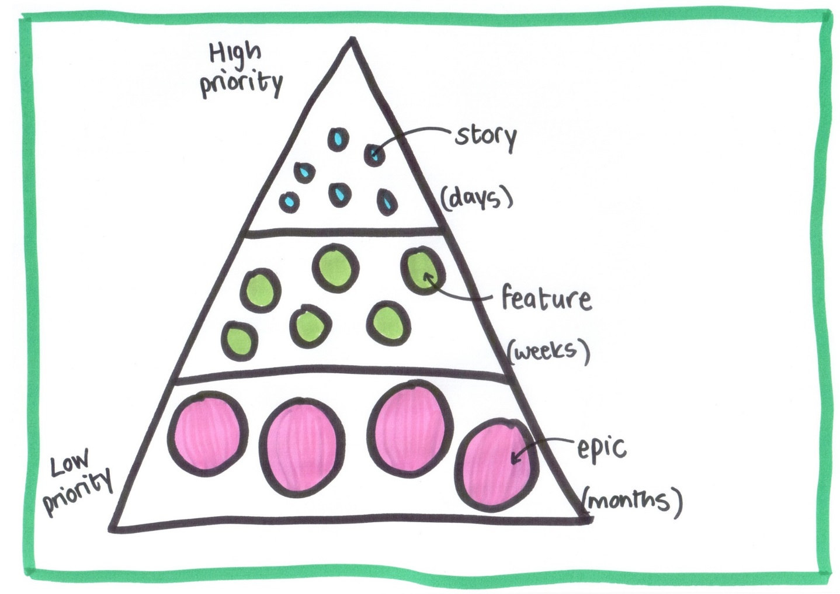
Decomposing Stories
- leanpub.com

Slide 27
Levels of Agile Requirements
Vision
Capability
Capability
A story too large to finish in one iteration
Feature
Feature
Epic
Epic
Story
Story
Story
Notes:
A statement phrased like a User Story could be so large that it encompasses an entire vision for a product or project. Teams try to define a hierarchy early-on that creates a vocabulary for quickly triaging the size of any given request that comes to the team.
Note, there are some Agile publications that state the hierarchy flows as follows:
Vision
Theme
Epic
Feature
Story
Pick the hierarchy that works best for your organization and stick to it. Understanding how many stories make-up a feature and mapping stories all the way up to themes will help track progress towards achieving the vision. Consider managing this hierarchy a form of Requirements Traceability within Agile.
___________________________________________________________________________________
___________________________________________________________________________________
___________________________________________________________________________________
___________________________________________________________________________________
___________________________________________________________________________________
___________________________________________________________________________________
___________________________________________________________________________________
___________________________________________________________________________________

Slide 28
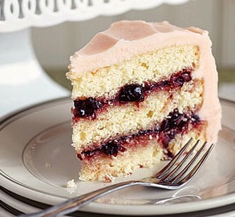
Slice it Up
Take slice of the whole rather than individual layers.
“An authenticated member can post a recommendation for a book”
✖ An authenticated member can fill out a recommendation form
✖ Information on a recommendation form is written to the database
✔ A member can post a written review about the book
✔ A member can post a rating about the book
✔ A member can post references to similar books
- Mike Cohn
Notes:
Typical Traditional/Waterfall Style projects rely on a Gantt Chart view of building the different layers of an application in somewhat of a sequential fashion, often with separate teams or groups of individuals being responsible for different layers.
User Stories are individual increments of a potentially shippable solution that add value to the User Role described within the story. Separating stories by different application layers does not maintain a potentially shippable product. Think of building each layer of the application necessary to complete a User Story as tasks that must be completed to deliver that increment of the solution.
Only in the event a User Story cannot be a “narrow enough slice” of the solution to be completed within the confines of a Sprint should a team consider splitting it apart, and that is through the use of Non-User Stories, which is covered at the end of this section.
___________________________________________________________________________________
___________________________________________________________________________________
___________________________________________________________________________________
___________________________________________________________________________________
___________________________________________________________________________________
___________________________________________________________________________________
___________________________________________________________________________________
___________________________________________________________________________________
___________________________________________________________________________________

Slide 29
Open vs. Closed Stories
Open stories often have no end in sight
“As a Publisher, I want to manage the ads I have placed”
Closed stories show an achievable, meaningful accomplishment
“As a Publisher, I want to change the expiration date of an ad”
“As a Publisher, I want to delete an ad that is no longer relevant”
“As a Publisher, I want to measure how many times an ad has been clicked through”
- Mike Cohn
Notes:
____________________________________________________________________________________________
___________________________________________________________________________________
___________________________________________________________________________________
___________________________________________________________________________________
___________________________________________________________________________________
___________________________________________________________________________________
___________________________________________________________________________________
___________________________________________________________________________________
___________________________________________________________________________________
___________________________________________________________________________________
___________________________________________________________________________________
___________________________________________________________________________________
___________________________________________________________________________________
___________________________________________________________________________________

Slide 30
Additional Approaches to Split Stories
Splitting by Acceptance Criteria
Splitting by User
Splitting by Items in a List
Splitting by Create/Read/Update/Delete or the Word “Manage”
Splitting by Keyword
Splitting with Lists
Splitting by Test Scenario

Slide 31
Size the Story to the Horizon
Focus attention on most critical areas first
Write stories at levels based on the implementation horizon If stories are further out, they can be Open/Goal Stories
“…Guest Member I want to register for an account…”
“…Authenticated Member I want to post a recommendation…”
“…Pioneer Member I want to submit feature suggestions…”
“…Critic I want to post reviews of a book…”
- Mike Cohn
Notes:
____________________________________________________________________________________________
___________________________________________________________________________________
___________________________________________________________________________________
___________________________________________________________________________________
___________________________________________________________________________________
___________________________________________________________________________________
___________________________________________________________________________________
___________________________________________________________________________________
___________________________________________________________________________________
___________________________________________________________________________________
___________________________________________________________________________________
___________________________________________________________________________________
___________________________________________________________________________________
___________________________________________________________________________________

Slide 32
Size the Story to the Horizon
Once a story is close to being started, break it down.
“As an Authenticated Member, I want to log into the system so that my information can only be accessed by me.”
...I want to log in with my username and password...
...I want to change my password...
...I want the system to warn me if my password is easy to guess...
...I want to be able to request a new password so that I am not locked out if I forget it
...I want to be notified if there have been three consecutive failed attempts to access my account...
- Mike Cohn
Notes:
When it comes time to prepare for Release Planning the team should look at stories within the backlog and break them down into small ‘atomic’ user stories that can likely be completed within a single iteration.
The example here describes how a goal story may be broken down.
___________________________________________________________________________________
___________________________________________________________________________________
___________________________________________________________________________________
___________________________________________________________________________________
___________________________________________________________________________________
___________________________________________________________________________________
___________________________________________________________________________________
___________________________________________________________________________________
___________________________________________________________________________________
___________________________________________________________________________________
___________________________________________________________________________________

Slide 33
Non-User Stories
Technology foundation stories
At times these can be stated in customer terms
Dependencies from external teams
Creative elements
Spikes
Other types of stories... defects, maintenance, training, etc.
As a developer, I want to upgrade to the latest version of the database software so that we have a supported product
Spike: As a developer, I need to investigate a semantic search algorithm to facilitate natural language searching of the person’s financial record.
Notes:
When the team feels they are in need of these Foundational Stories or Non-User Stories, they should first understand the underlying point of these types of stories. Another thing to examine is how these can help the team achieve their commitment.
These types of stories are NOT meant to give ways for the team to 'shirk' the User Stories that are committed to during the Sprint Planning session, but to enhance the ability to complete those User Stories.
The biggest type of Foundational Story that has been misused and abused is the Spike. This is solely added to Backlog in order to do research or find a solution to help in the implementation of another User Story. Spikes are absolutely NOT intended to allow for more work to enter into the Sprint after the Sprint has begun.
Another way to look at a spike is simply if the output of a User Story is working software, the output of a spike is a decision or enough additional information to determine the next steps forward. And because spikes do not result in demonstrable software at the end of the sprint, then each spike should have acceptance criteria associated with it so that it is clear what it means for that spike to be complete. Without acceptance criteria, spikes can often be a magnet for waste, as teams may spend time “researching” something, but with no clear definition on what value that effort is intended to drive, it may be of little to no ultimate use.

Slide 34
Non-User Stories: Constraints
Constraints often do not represent user functionality.
Should be documented and remain visible for team, but does not go into the product backlog.
Should be stated in measurable terms and be testable
As a patient, I want the system to function like the other systems in the suite so that it is familiar and easy to use.
As a stakeholder, I want page load times to conform to current standards so that patients will be able to use the system on a dial-up connection.

Slide 35
Functional vs. Non-Functional
Functional - Captured through User Stories As a <user role>, I want to <desired FUNCTION>, so that <desired benefit>. Acceptance Criteria could also elaborate on functions.
Non-Functional - Captured in Several Ways
Acceptance Criteria
Definition of Done
Constraints of the Product
Notes:
____________________________________________________________________________________________
___________________________________________________________________________________
___________________________________________________________________________________
___________________________________________________________________________________
___________________________________________________________________________________
___________________________________________________________________________________
___________________________________________________________________________________
___________________________________________________________________________________
___________________________________________________________________________________
___________________________________________________________________________________
___________________________________________________________________________________
___________________________________________________________________________________
___________________________________________________________________________________
___________________________________________________________________________________

Slide 36
Guidelines for Good Stories
Start with Goal Stories
Slice it Up
Open vs. Closed Stories
Size the Story to the Horizon
- Mike Cohn
Notes:
Think of this as a series of steps for building a Product Backlog:
Start with Goal Stories – what are all the things a user wants to accomplish
Slice it Up – make sure you are focusing on increments of software that are valuable to the customer, and not layers of the application
Open vs. Closed Stores – make sure there is a meaningful objective and an “end” to each one
Size the Story to the Horizon – once you’re approaching the release the goal will be accomplished within, break it down into granular User Stories
___________________________________________________________________________________
___________________________________________________________________________________
___________________________________________________________________________________
___________________________________________________________________________________
___________________________________________________________________________________
___________________________________________________________________________________
___________________________________________________________________________________
___________________________________________________________________________________
___________________________________________________________________________________
___________________________________________________________________________________
___________________________________________________________________________________

Slide 37
Outputs from Story Types
User Stories Demonstrable working software for acceptance by the Product Owner.
Foundational Working software, infrastructure, or systems that enable User Stories to be completed.
Spikes Information or a decision.
Notes:
When the team feels they are in need of these Foundational Stories or Non-User Stories, they should first understand the underlying point of these types of stories. Another thing to examine is how these can help the team achieve their commitment.
These types of stories are NOT meant to give ways for the team to 'shirk' the User Stories that are committed to during the Sprint Planning session, but to enhance the ability to complete those User Stories.
The biggest type of Non-User Story that has been misused and abused is the Spike. This is solely added to the Product Backlog in order to do research or find a solution to help in the implementation of another User Story. Spikes are absolutely NOT intended to allow for more work to enter into the Sprint after the Sprint has begun.
Another way to look at a spike is simply if the output of a User Story is working software, the output of a spike is a decision or enough additional information to determine the next steps forward. And because spikes do not result in demonstrable software at the end of the sprint, then each spike should have acceptance criteria associated with it so that it is clear what it means for that spike to be complete. Without acceptance criteria, spikes can often be a magnet for waste, as teams may spend time “researching” something, but with no clear definition on what value that effort is intended to drive, it may be of little to no ultimate use.
___________________________________________________________________________________
___________________________________________________________________________________
___________________________________________________________________________________
___________________________________________________________________________________

Slide 38
What to Watch Out For
Mike Cohn’s ‘Catalog of Story Smells’
Stories that are too small
Stories too big....too many being split later
Interdependent stories
Goldplating
Too much detail
Interface detail too soon
Thinking too far ahead
Lack of customer participation, writing and prioritizing

Slide 39
Q & A

Slide 40
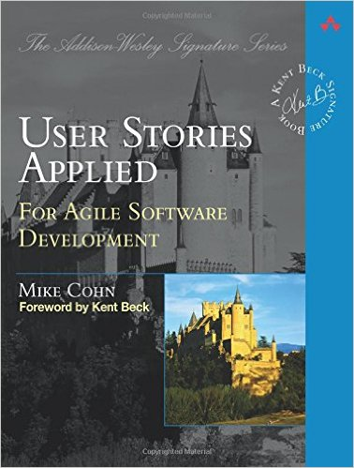
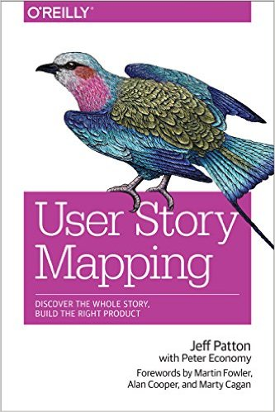
References

