Slide 1
Becoming Invaluable:
The T-Shaped Professional
Notes:
Welcome to ASPE’s presentation on T Shaped professionals…..
Very passionate about this subject and I am sure you are going to start seeing it pop up in the business media and hopefully as a proactive strategic discussion around workforce management in the boardroom.
What I am excited about is that it is practical, easy to understand, flexible across a lot of industry’s and it’s unique and different enough to engage seasoned veterans and millenians, everyone in between.

Slide 2
Why We are Here: Major Disruption in Workers Needed
It took 77 months to get to pre recession
employment levels with the last recession, it
normally takes 18 months
The % of management positions has decreased
from 28% of the economy in 2000 to 24% in 2010
Positions requiring creativity and problem solving have
increased by 4.8M from 2001 to 2009
Knowledge workers are engaging in creativity and
problems solving, and they have specific skill
requirements

Slide 3
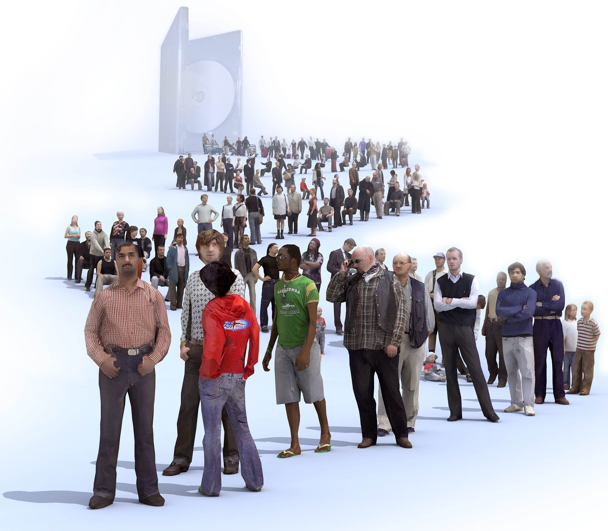
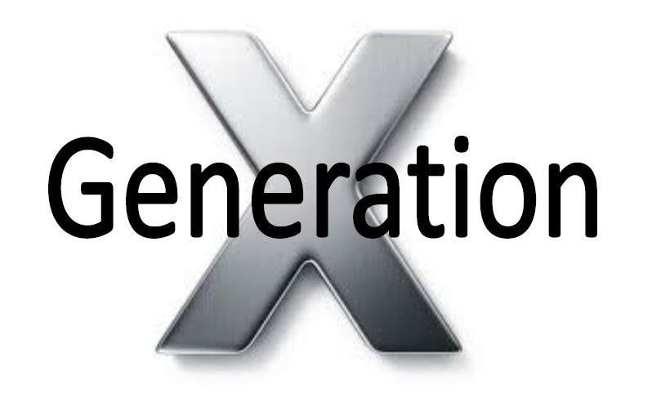
Millennials
Expanding 80M Gap
in Ready Now! Leaders
Notes:
This is our current reality …..
It’s not a theory or a projection or hypothesis
Roughly 10,500 – 11,000 per day every day for the next 20 years

Slide 4
Why We Are Here: Major Disruption in Workers Needed
Knowledge workers facilitate greater productivity
and stronger decision-making
The fate of individuals and companies hinges on T-
shaped people
Unfortunately, T-shaped people are the exception
rather than the rule; not having these well rounded
leaders adversely affects companies every day
Is this condition Fatal? Serious? Can it be cured?
Notes:
The big take away from here is that companies that respond proactively to this very real threat are going to hold a key competitive advantage in their market space.
The more tied a company is to performance metrics by outside stakeholders ------ > i.e. shareholders and investors the more they should be concerned with addressing this risk.
Fortune 1000, 500, 100 firms are at the greatest risk!
Less nimble, slower to react to the market,

Slide 5
T-Shaped Agenda
Explain the theory of “I” and “T” shapes skills
“I” shaped person …
Deep, intensive technical knowledge
Lacking broad “soft” skills
“T” shaped person …
Deep, intensive technical knowledge
Possesses skills and experiences outside of technical field
T shaped professional is just as technical as I shaped. BUT – they also possess other skills, experience, and interests.
Connecting “T” shaped to today’s business needs
Notes:
I shaped people can be anyone who is a specialist…..
Neurosurgeon
Financial Analyst
IT Director
Software Engineer
Pro Athelete

Slide 6
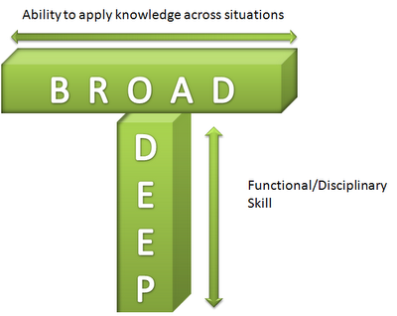
The T-Shaped Professional
courtesy of:
Egon Luftenegger

Slide 7
Why is being T-Shaped Important?
Well rounded individuals have clear advantages over
people who are more narrowly focused
Translation: People who have balanced skill sets and also have lives outside of work perform better inside of work!
In the end, this research should lead us to one place:
Help us achieve our professional and personal life goals
A well-rounded person has a better chance of realizing
their professional and personal goals
Identifying, recruiting, hiring, training, and promoting T-
shaped professionals is critical to your company’s success

Slide 8
The I-Shaped Professional
Deep knowledge in a narrow area
Intensive study over many years
An authority in his or her field
A knowledge expert, programmer, engineer, scientist, or technician
Indispensable to the company

Slide 9
Structure of the I-Shape…
The “I” in I-shaped professional looks a lot like the #
______________?
This is not by accident
I-shaped professionals tend to be very one-dimensional.
They know everything about their very narrow field of
study, often to the exclusion of everything (and everyone)
else
Intractable “I” shaped people should never be promoted
into leadership roles
If we don’t fix this, we are doomed to continually bring in
outside talent to lead our engineers
Notes:
The IT Industry recognized this was happening YEARS AGO…..
Kim Crider – Harvard
Jim Sporeor – IBM University
T - Summit

Slide 10
How widespread is this?
In clinical terms – It’s An Epidemic!
Nearly everyone in the technology field is I-shaped
The same personal qualities that make them great engineers /
scientists also make them I-shaped by definition
This has been proven over and over in research
People tend to be more forgiving of this in large engineering /
technology companies
Put the best & brightest (and most I-shaped) in a office / cube
You slide a pizza under the door every day
Every Friday, they slide some source code out to you
We’ve created a popular culture where the smarter you are, the more
“tunnel vision” you’re supposed to have, the more idiosyncratic you
are and the more difficult you are to work with
Notes:
TOP Performing companies will not let you advance if you these Idiosyncratic tendencies
Fidelity
Microsoft
Redhat
Amazon
Google

Slide 11
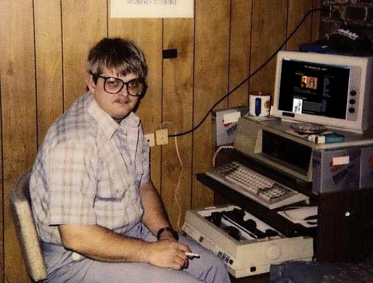
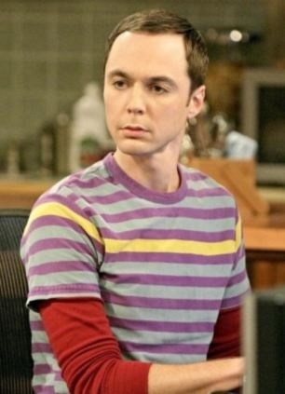
Get the picture?
Notes:
NASA might be a place where you can hide if you are a SUPER I shaped performer.
Non – customer facing / stakeholder dependent roles?

Slide 12
The T-Shaped Professional
Just as technical as I- shaped
Possesses other skills
Has other interests
Works better with people
A more rounded individual

Slide 13
Structure… part II
Notice that the “T” in T-shaped professional reminds us of
Da Vinci’s famous drawing: L’uomo Universale
This is not by accident
T-shaped professionals tend to be multi-dimensional,
whole human beings. They know their technical area very
well, but they also have other talents, skills, and interests
“T” shaped people are your company’s future leaders

Slide 14
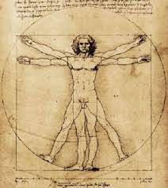
The Renaissance Person
Notes:
Its important to note that TIME is a huge factor in decision making on how YOU invest in your career and personal development. This isn’t the 1400’s. Demands on our time based on our information age society are 100x more limited.
That’s why we feel it is imperative that you recognize and actively plan for what will set you apart from the crowd as the skills and requirements for all professionals shifts in the coming years.
Think this is cool……

Slide 15
The Renaissance Person
Da Vinci’s drawing is very familiar to us
This phrase comes from an author from the Italian Renaissance
Castiglione wrote a book called “The Book of the Courtier”
He described the ideal qualities of young men in the royal court
“Hard” skills – martial arts, military strategy, horsemanship,
weapons
“Soft” skills – art, music, dance, wine, languages
These men needed to effortlessly master each skill
Castiglione called this L’uomo Universale – the universal man
We call this person a “Renaissance Man” (or Renaissance Woman)

Slide 16
Name a Renaissance Person
Hard to do, isn’t it?
In previous classes, participants can’t think of a real person
The names that come up most often are Historical & Contemporary
Thomas Edison : phonograph, the incandescent light bulb and one of the earliest motion picture cameras
George Washington Carver : Botany, nutrition, multiple products from one source (cosmetics, dyes, paints, plastics, gasoline, and nitroglycerin) from peanuts
Di Vinchi: invention, painting, sculpting, architecture, science, music, mathematics, engineering, literature, anatomy, geology, astronomy, botany, writing, history, and cartography
James Bond, Oprah Winfrey, Steve Jobs…. NO, ______________ ? Name Someone!
A bit over the top but if you bring it down a few levels, you get the point
Curiosity and interest across a wide spectrum
Ability to partner and team with others
Interest to solve problems and look for solutions in different ways

Slide 17
Rapid Changes – The World Doesn’t Stay the Same
Section Two

Slide 18
Challenges Businesses Face
Notes:
If you think about how far technology has come and how quickly it is changing the workplace …. This is the result.
Technology is outstripping our ability to keep up in terms of human adaptability to the changing business environment.

Slide 19
Challenges Facing Organizations in 2015
Speed
Rapid pace of disruption and change
Businesses that can’t handle change, lose and lose quickly ”adaptive / nimble”
Productivity Challenge
Key to profitability
Automation driven
Finding Competitive Advantage
Hiring the best and the brightest “WAR FOR TALENT”
Customer knowledge “internal and external” critical
Can change quickly
Product Creation hit or miss
Driving elements of Lean Start-up into organizations
Keeping High Quality in-demand Workers
Salary increases have slowed drastically since 2008 and right now it seems the only way to get a raise is if you move to another company

Slide 20
Evolution of Business: 1870’s 2001
Industrial revolution through the information age
Managers monitor, report, track and plan, schedule and review (solve problem)
Workers build deeper and deeper expertise in selected area
Apprentice
Journeyman
Master
Driven by professional certifications or role specific mastery, no thought on why
Notes:
Professional certifications:
driven by the market by need
developed because there was and opportunity to own the process, own the IP and own the revenue stream.
When you own all three you have less incentive to openly serve the captive market you are certifying.

Slide 21
Evolution of Business: 2001 to ?
Knowledge Age (knowledge workers)
Significant reduction in management of task to…..
Moving to management of vision, goals and direction (providing coaching and mentoring)
Workers grow two ways
Deep into an expertise or profession
Wide into problem solving, communication, creativity, leadership, teaming skills, agile strategic mindset
i.e. much higher cognitive skills
Workers driven to consider the whys and solve problems

Slide 22
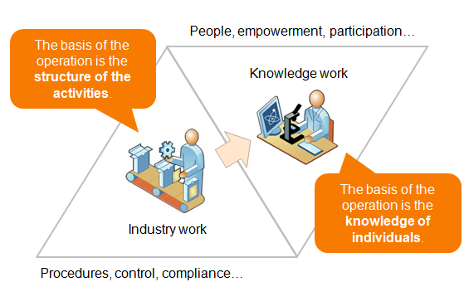
Visual of the Evolution of Business

Slide 23
Supporting Facts: The Second Machine Age
IBM Watson has increased in speed by 240% over the last two
years alone
Over 15 years device(s) sales have grown ten fold to 2.5B a year
3B people are connected to the Internet using more than 30
terabytes of data per second
Society Impact (near future) | Job Impact Now (white collar)
self driving cars full robotics manufacturing surgical automation automated mass transport anesthesiologists | discovery screening for law firms stenographer in court rooms financial, sports reporting data analysts transport logistics audience …….Your thoughts?
Notes:
Essentially a NET – ZERO effect on job impact.
Technology Automation, Cloud computing, Self monitored networks will probably create more jobs and opportunities than it destroys
The point is not to instill fear and unease; its to help you prepare and equip you for the coming changes

Slide 24
This a Knowledge Worker
Knowledge Workers
Higher than average intelligence
Most likely smarter than leaders of the company
Do not want to be micro-managed
Have some type of management experience
Have some type of project experience
Lack business financial skills (accounting side of business)
Their Work
24 by 7; meaning some level of work is always there
It is creative
Subjective; success and measurement is not black and white
It is team orientated
Time sensitive
Usually part of a project or change initiative

Slide 25
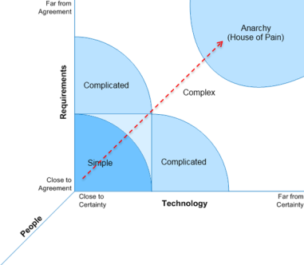
Why Knowledge Workers are Needed
Notes:
The Stacey Matrix is a model proposed by Ralph Douglas Stacey to determine the characteristics of work based on the degree of certainty and the level of agreement. People do the work, and they have to deal with requirements and technology. Requirements represent the “What” we want to do or deliver. Technology represents “How” or the delivery architecture. The delivery architecture is made up of processes and tools. These can be highly sophisticated or simple. By understanding the work characteristics we can understand the approach that best fits the work. Simple things can be accommodated by defined processes successfully, but as things get more complex, the way we approach the work needs to account for the need to learn. Agile is built for the need to learn. A helpful question: “Is it a widget or is it invention?” When it is a widget, that represents a known thing that we want to replicate. When it is invention, we don’t really know what it is, or what it needs to be. Invention requires learning to be successful. Invention also requires failing fast so that we don’t fail slow. Edison was reportedly asked how it feels to have failed over 10 thousand times inventing the light bulb. His answer was that he didn’t fail 10 thousand times, he found 10 thousand ways that didn’t work. If each failure was slow, like it took 9 months per failure, do the math, Edison would not have been the one to provide the light bulb. He wouldn’t have lived long enough. Invention requires fast failure or fast feedback cycles which create fast learning.
________________________________________________________________________
________________________________________________________________________
________________________________________________________________________
________________________________________________________________________
The Stacey Matrix

Slide 26
Being “T” Building “T” Shaped Professionals
Section three

Slide 27
Just Convert the “I”s to “T”s
Conventional wisdom says that we should find all of our I-shaped people and make them T-shaped
If only it were that easy
People aren't software!
This is Upgrading a Person!
That’s a lot harder to do than upgrading a PC.

Slide 28
Understand the Problem
We aren’t dealing with software or hardware
This is human nature at its very deepest
Translation – we can try to influence people and their choices, but
we can’t make them change
Trying to change someone’s personality is like trying to teach a pig to sing
It doesn’t work
And it annoys the pig
Once we realize this isn’t something to be upgraded like a PC, we at least
begin to understand the problem (maybe even move toward a solution)
Focus on awareness and skills development

Slide 29
How do we move “I”s to “T”s?
Must change the management construct we work within
From hierarchical model to self-organizing model
Must drive autonomy and empowerment as close to the work as possible
Decision making must happen were the work happens
Managers must change how they manage
Coaching, mentoring, advising, vision communication, goal setting, goal
readjustment, goal communication, barrier breaking, and trust developers
Knowledge workers must build some skills and take some responsibilities
Skills: Building out the top of the “T”
Responsibilities: Accepting that a flat organization means you take
responsibility for your actions, you make decisions and you deal with conflict
(that is not the managers job)

Slide 30
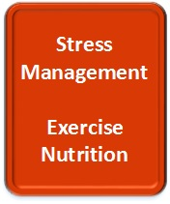
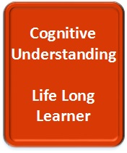
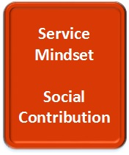
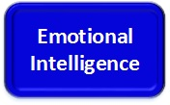
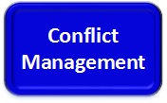
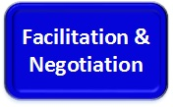
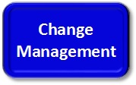
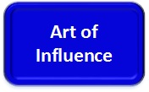
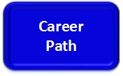
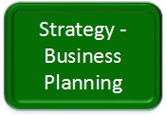
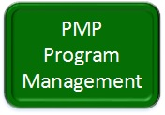
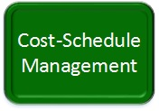
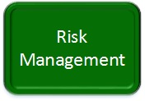
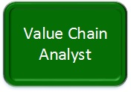
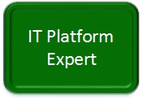
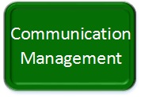
Developing T-Shaped Leaders

Slide 31
Professional Skills Buildup
Influence
Change Management
Facilitation and Negotiation
Conflict Management
Emotional Intelligence

Slide 32
Corporate Approach
Acknowledge the Leadership Gap
Prioritize resource development and align it with corporate strategy
Develop a culture that supports the new knowledge workers needs
Develop a “T” Shaped Leadership program
NOTE: Any company or organization that relies on IT to be
competitive must do this!

Slide 33
Self-Organized teams: The T-Shaped Business Structure
Section five

Slide 34
Self-Organized Teams

Slide 35
Individual Approach
Take ownership over their career path
Prioritize “balanced” personal development and align it
with where they want to be in their career
Objectively benchmark their current business,
professional and whole self skills
Develop a plan and realistic approach to development
of their “T”
Be open to resetting their course every 6-8 years

Slide 36
Summary
The Leadership GAP is Massive
Opportunities abound for T-shaped professionals
Disrupted Workforce: rapid change in business skill requirements are being driven by IT
Balance “hard skills” with “soft skills”
Converting I’s to T’s
Must shift mindset, awareness, prioritize continuing education path
Company Culture: Drives workforce leadership requirements
Heirarchy vs. Open Organization
Future Leaders Must Own their own Development
Traditional pathways to Leadership will require more discipline
Future Leaders will be T-Shaped Professional Knowledge Workers
Balanced Hard & Soft skills l Self Aware / Self Managed l Leadership skills aligned to their Company l Whole Self l Autonomous l Accountable
Notes:
1. Technical experts with true ownership over their T shaped skillset will have more opportunity to lead organizations and be elevated by their peers more rapidly
2. Identifying, benchmarking, developing specific T shaped competencies will be a focus for HR departments and business unit leaders within IT organizations
3. E.I., Conflict Mgt, Change Mgt, PM, Influence are baseline soft skills….. Others will be driven by company culture, market scope, people management diversity. The more global your customer base, the broader your T should be
4. The more open the organization the faster you need to develop your T if you want to succeed as you grow within the company
5. Don’t count on HR to provide a clear career path to the top; they will be playing catchup for the next 5-10 years

Slide 37
Open Q & A

